Slide 1
Topic: Multiplication
EQ: What are Strategies I can Use to Multiply Whole Numbers?
Year 7 Mathematics
Mrs Parlevliet

Slide 2
Contents
Glossary or Formula Page
Page
Date
Essential Question
24
7
30
Word or Formula
Definition or Example

Slide 3
Tasks
24
7
30
Topic
Essential Question
Questions
Notes
Summary
1
2

Slide 4
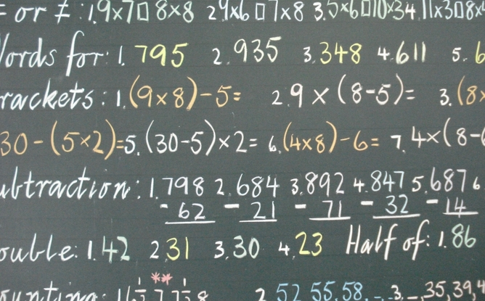

Five Questions (LHS)
Topic: Multiplication
EQ: What are strategies I can use to multiply whole numbers?
Date: 22/03/2021
Write $\frac{9}{7}$ as a mixed number.
$6−10=$
List in descending order: 5, 7, -9, 11, -4, 3, -8
Solve $5×4$
A collection effort by a charity to help those affected by a tsunami finds that it has gathered 588 first aid kits. There are 21 shelters that house roughly equal number of people who have been affected. The charity decides to distribute the first aid kits equally between these.
How many people receive a first aid kit?
This Photo by Unknown Author is licensed uder CC BY-ND
Notes:
$1\frac{2}{7}$
-4
11, 7, 5, 3, -8, -9
20
$588÷21=28$

Slide 5

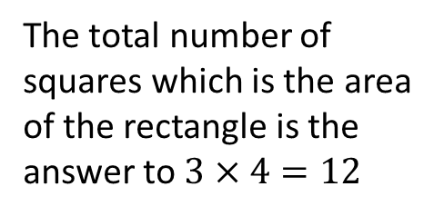
24
7
30
Topic: Multiplication
Date: 22/03/2021
EQ: What are strategies I can use to multiply whole numbers?
What is a whole number?
Whole numbers are numbers, 0, 1, 2, 3, 4, 5, … and so on. Fractions and decimals are not whole numbers
What is the array strategy?
A multiplication array is a collection of things arranged in rows and columns. We can use it to multiply numbers.
Rows are arranged horizontally, from left to right. Columns are arranged vertically, from up to down.
Example 1
$3×4=$ can be solved by drawing an array with 3 rows of 4 squares.
Factors, numbers being multiplied
4
The total number of squares which is the area of the rectangle is the answer to $3×4=12$
3
WICOR
$$3×4=12$$
Product, the answer to a multiplication

Slide 6


Slide 7

TASK (LHS)
Question 1: Use the array model to evaluate the following:
$7×2=$
$9×5=$
$4×5=$
$12×13=$
$14×3=$

Slide 8

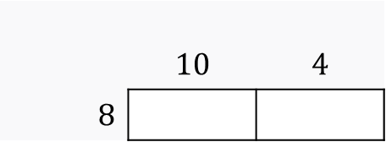

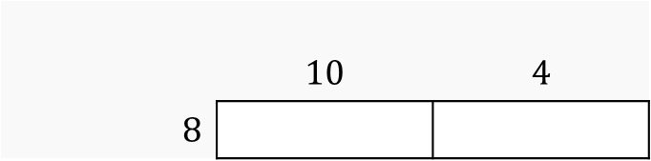

24
7
30
Topic: Multiplication
Date: 22/03/2021
EQ: What are strategies I can use to multiply whole numbers?
What is the area model strategy?
The product of two numbers can be found by using the distributive law.
Example 1
$$8×14$$
1. We can write $8×14$ as $8×(10+4)$ because $14=10+4$
2. We then set up rectangles to work out the area of them like this.
 | $$10$$ | $$4$$
$8$
3. We work out the area of the rectangles by multiplying the lengths with the height.
 | $$10$$ | $$4$$
$8$
$$8×10=80$$
$$8×4=32$$
WICOR
4. Evaluate the sum of the area of the rectangles, $80+32=112$.
This means that $8×14=132$

Slide 9

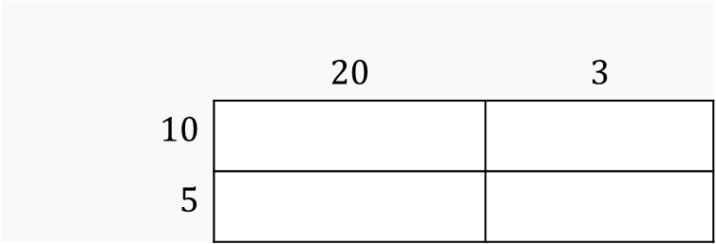








24
7
30
Topic: Multiplication
Date: 22/03/2021
EQ: What are strategies I can use to multiply whole numbers?
What is the area model strategy?
Example 2
$$15×23$$
$15×23$=
$$(10+5)×(20+3)$$
 | $$20$$ | $$3$$
$10$
$5$
$$10×20=200$$
$$10×3=30$$
$$5×20=100$$
$$5×3=15$$
$$200+100+30+15=345$$
$$15×23=345$$
WICOR

Slide 11
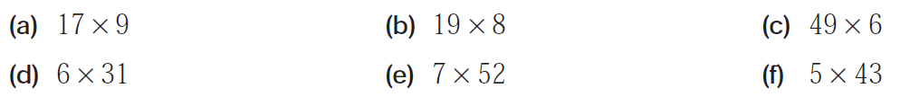
TASK (LHS) MFWA 1 Multiplication
Question 2: Use the area model to evaluate the following:

Slide 13
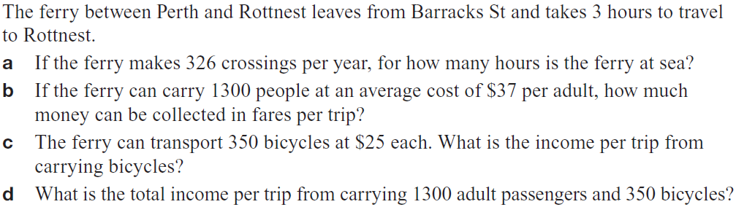
TASK (LHS) MFWA 1 - Multiplication
Now try some worded questions

Slide 14

Write Your Summary
Write a summary that answers the Essential Question: What are strategies that I can use to multiply whole numbers?
Include an example in your answer.
This Photo by Unknown Author is licensed under CC BY-SA

